Slide 1
HOSPITALITY ANALYTICS PROJECT
Presented By Group-5
Yusuf Ali
Sumit Pondkule
Rohit Hazare

Slide 2
Project Overview:
Tools Used: Excel, Power BI, Tableau
Purpose: Analyze hotel bookings, revenue trend, and performance KPIs
Focus: Data cleaning, visualization, and business insights

Slide 3
Project Objective:
Analyze hospitality booking data
Identify revenue trends
Track occupancy performance
Monitor booking status
Create interactive dashboards for decision making

Slide 4
Dataset Overview:
Booking ID
Booking Date
Revenue Generated
Booking Status
Booking Platform
Room Category
Country / City

Slide 5
Excel Module:
Import raw hospitality dataset
Create relationships between tables
Remove duplicates
Handle missing values
Format dates and numbers

Slide 6
Excel Analysis:
Pivot tables for revenue & booking analysis
Country wise revenue
Most used payment methods for bookings
Booking status analysis
Most used booking platform
Revenue trend by month
Charts for quick insights

Slide 7
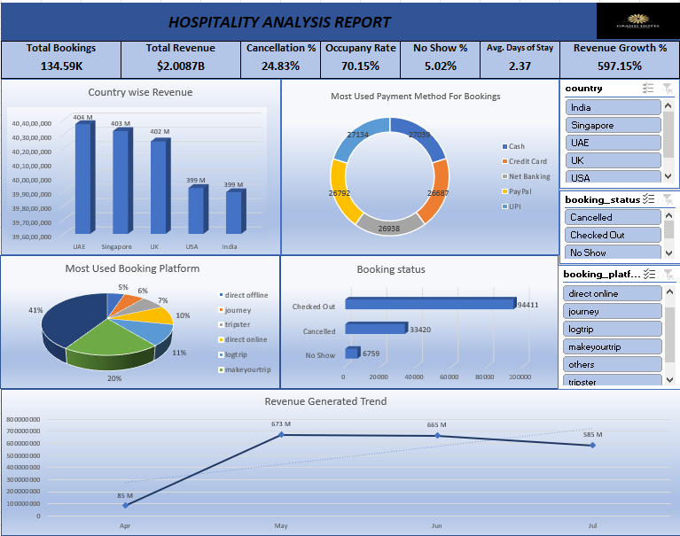
Excel Dashboard:

Slide 8
Power BI Module:
Import cleaned data from SQL
Create relationships between tables
Build measures using DAX
Example metrics: Total Revenue, Total Bookings, Cancellation Rate, Occupancy Rate

Slide 9
Power BI Dashboard Features:
KPI Cards (Total Revenue, Total Bookings, Total Cancellation)
Booking Status Analysis Chart
Total Revenue by Country and Month
Total Bookings by Month
Slicers (Country, Booking Date, Booking Status)
Drill-down method used in Total Bookings by Month chart

Slide 10
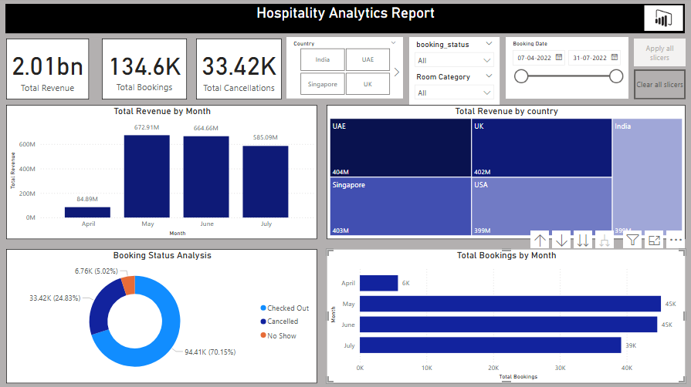
Power BI Dashboard:

Slide 11
Tableau Module:
Connect dataset
Create calculated fields
Apply filters
Build interactive dashboards

Slide 12
Tableau Charts Used :
Total Revenue by Country tree-map
Revenue Trend line chart
Booking Status pie chart
Month wise Occupancy Rate column chart

Slide 13
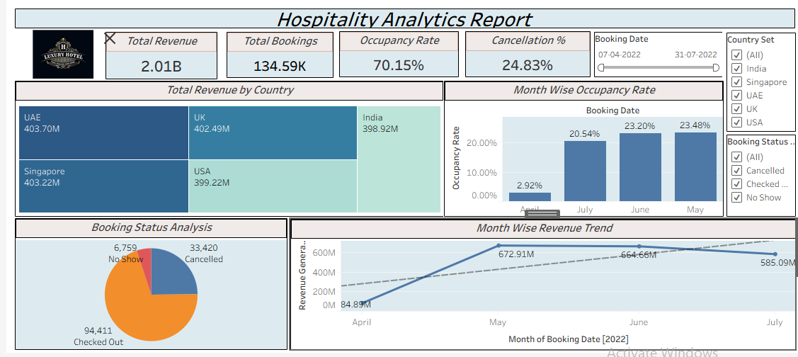
Tableau Dashboard :

Slide 14
SQL Module:
Data cleaning steps performed:
Removed duplicate records
Removed NULL values
Corrected data formats

Slide 15
SQL Analysis Queries:
Total Revenue by Country
Monthly Revenue Trend
Booking Status Analysis
KPI Cards (Total Revenue, Total Bookings, Total Cancellation)

Slide 16
Hospitality Dashboard Insights
Track revenue trend and overall performance
Understand hotel booking patterns
Identify peak booking months
Analyze booking cancellations
Track important KPIs which helps to measure hotel performance.
Analyze total occupancy rate

Slide 17
Conclusion:
Successfully analyzed hotel booking data using Excel, SQL, Power BI, Tableau and SQL.
Performed data cleaning, transformation, and analysis to ensure accurate insights.
Identified key metrics such as Total Revenue, Occupancy Rate, Booking Trends, and Revenue Growth.
Built interactive dashboards to visualize booking patterns and revenue performance.
Together they help hospitality businesses make data-driven decisions

Slide 18
THANK YOU..!!

